Slide 1
Politics for the many
The trade union campaign for political reform
Notes:
Introductions
Thank you for coming along
Politics for the Many is a campaign group for trade unionists who want political reform.
The campaign is currently focusing on the abolition of the House of Lords and a constitutional convention.

Slide 2
Why the campaign was set up
The system is stacked against working people
Erosion of trade union rights
Big corporations have too much control
Decisions are not being made democratically
Local government is being hollowed out
People feel alienated and are disengaging
Notes:
Why the campaign was set up
Because system is stacked against working people
Successive Tory governments have eroded trade union rights
14 employment and trade union acts since 1980
Many have been introduced swiftly after general elections won by the Tories and undone the work of previous Labour governments
They introduced new restrictions on trade unions For example - the Trade Union Act 2016 has made it much harder to take collective action
The list of statutory obligations on unions has grown exponentially
Law on trade unions in Britain is now amongst the most restrictive in the Western world
Big corporations have captured the state and its institutions
Big corporations have captured the state and its institutions
They are run by a small, elite group of people based principally, although not exclusively in London – INSERT EXAMPLES
Decisions are not being made democratically
The rights of the people and the sovereignty of the people should sit at the heart of a democracy. But we have the sovereignty of the Crown in Parliament.
There is a relationship between economic, social and political rights.
People need economic security – the right to a job and a decent home – if you do not have power over your own life and workplace, how are ou going to get it over the rest of your life.
Reform should start with the rights of citizens
Radical reform works where people are involved in it
Local government is being hollowed out
Contrary to much talk of giving people more power over their communities – INSERT EVIDENCE THIS HAS NOT HAPPENED
Cuts to LA budgets means some LA are reducing back to statutory services only.
Cuts mean some services and facilities are being permanently outsourced or handed over to communities to run for themselves – for example leisure facilities or libraries because Councils are unable to maintain them.
There is no guarantee that the organisations who take them over are ethical or interested in the community or that they will come back in-house should a future government start to properly fund local government.
People feel alienated and are disengaging
Reform must also deal with the loss of trust in politics. People feel politics is distant - it happens somewhere else, not in my community.
There are ideas and participatory reforms flourishing at a local level. New organisations and movements are being set up from the grassroots with their own structures and voices and they are taking action proactively – how do we bring these into the national arena and into our institutions?

Slide 3
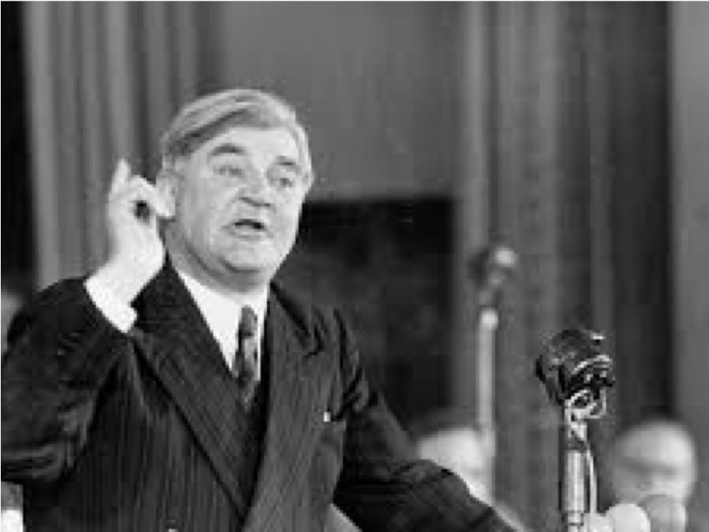
Nye Bevan, 1952,
‘In Place of Fear’
There is “one practical question: where does power lie… how can it be attained by the workers?”
Notes:
This is Nye Bevan
He was a WelshLabour Party politician who was the Minister for Health in the UK from 1945 to 1951. He spearheaded the establishment of the National Health Service.
Bevan was a lifelong champion of social justice, the rights of working people and democratic socialism.
This quote is from a book he published in 1952.
The introduction of the NHS and welfare state in 1948 halved inequalities in health in Britain between the 1930s and early 1950s. The strongest correlation to poor health is poverty, and the longer people live in poverty the shorter lives they can expect to live.
What we can now be sure of is that as income and wealth inequalities rise, so too do health inequalities. When it comes to providing a health service, it is harder to provide a good health service in a more economically unequal country.
In August 2018, a US study showed that life expectancy in the UK fell, while other western countries improved.
More information at: http://classonline.org.uk/pubs/item/in-place-of-fear

Slide 4
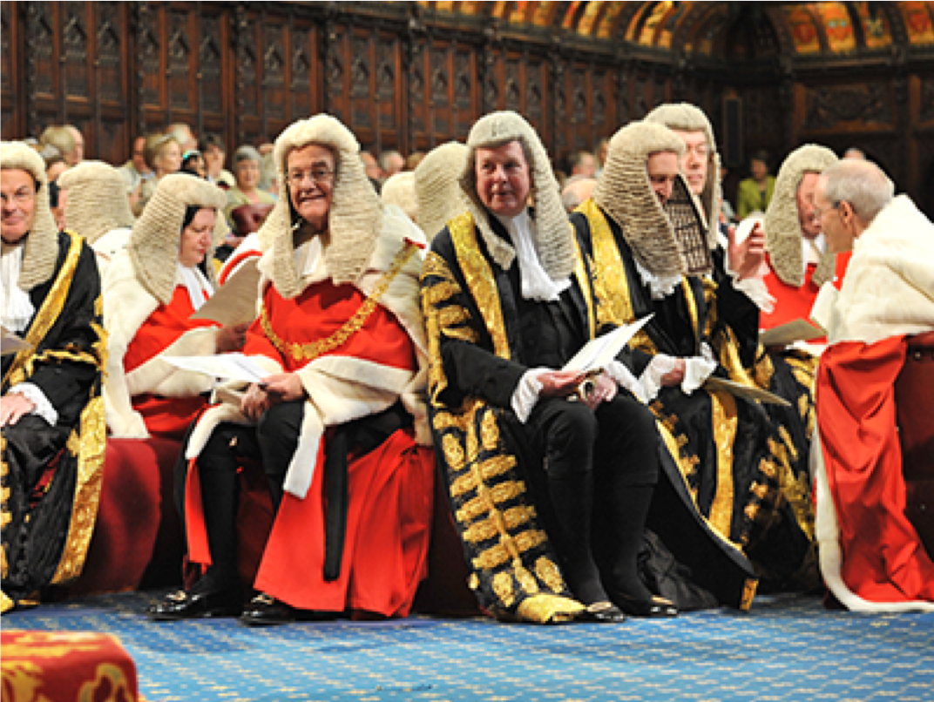
This is where power lies
Notes:
To build a politics for the many, the House of Lords has got to go

Slide 5
About the House of Lords
Nearly 800 lords (we have 650 mps)
Over 90 hereditary aristocrats
Claim £305 a day tax-free
They can change laws and delay laws
Many don’t even have a direct email
Only one is from a manual trade
Notes:
For far too many of its members, the second chamber of our parliament is a cosy club for the privileged few.
But this is not just another private members’ club – it is one which has real powers over the law of the land.
We’re basically alone in Europe for having a fully-unelected revising chamber. And no other country in the democratic world has a second chamber bigger than ours. Globally, only Communist China has a bigger body, and they merely meet to rubberstamp government policies. France manages on 348 members. Spain with 257. India, with over a billion people, has just 245 and Japan 242.
It’s time to abolish the bloated House of Lords and create a new chamber to revise our legislation – one where the public picks the members, and can hold them accountable.
How much does the House of Lords cost?
It seems the only time the public is allowed into the House of Lords is to pay the bill.
The House of Lords is an unacceptable burden on the public purse.
Peers are able to claim £305 a day tax-free each day they attend, plus some travel costs. Between February 2014 to January 2015, £21 million was spent on Lords allowances and expenses, with the average Peer receiving £25,826.
It can be hard to contact Members of the House of Lords as many don’t even have a direct email address.
The House of Lords is said to be a house of experts who have been chosen because of their specialist knowledge. Expertise is used as an argument for what makes the House of Lords different from the House of Commons, and also for its legitimacy.
However, the field from which the Upper Chamber brings the most experience is politics. In the current House of Lords, 27% of Peers have representational politics as their main profession prior to entering the Lords, the majority former MPs. A further seven percent of Peers are former political staff or held senior positions in political parties.
The legal professions are well represented (7%) as is business and commerce (9%) and banking and finance (6%). Two Peers worked primarily as staff of the Royal household prior to entering the Lords, whilst only one Peer has a manual trade as their former profession.

Slide 6
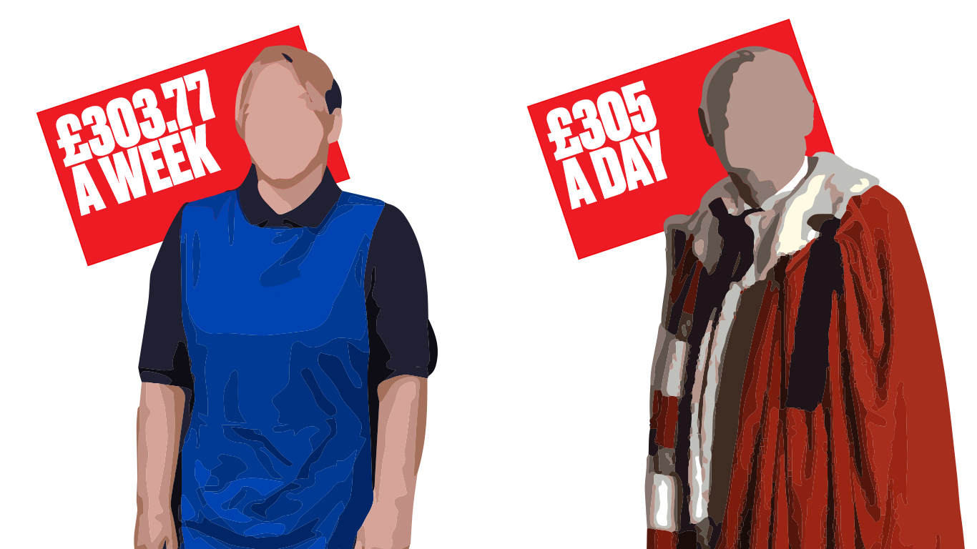
Compare the market
Worker on NMW
£303.77
37 hours at £8.21
HOUSE OF LORDS
£305
per day tax free
Notes:
Eligibility to claim
Members of the Lords, who are not paid a salary, may claim a daily allowance of £305 for each qualifying day of attendance at Westminster. https://www.parliament.uk/mps-lords-and-offices/members-allowances/house-of-lords/holallowances/explanatory-notes/201819/#jump-link-4
“Membership of the House of Lords is neither an office nor employment and therefore payments are not liable for income tax. This was confirmed independently by the Senior Salaries Review Body (SSRB)."
https://www.parliament.uk/documents/lords-finance-office/2018-19/financial-support-for-Members-briefing-note-2018-19.
Whereas someone over the age of 25, being paid the National Minimum Wage (NMW) will need to work 37 hours and still get £1.23 less than a Peer does for a day.
If you are between 18 and 20, you will have to work nearly 50 hours to earn the same amount.
NMW – National Minimum Wage rate at April 2019
https://www.gov.uk/national-minimum-wage-rates

Slide 7
To build a politics for the many, the House of Lords has got to go
Abolish the House of Lords
  Replace it with a fairly elected senate of the nations and regions
Hold a constitutional convention
  To look at wider reform of our state and politics
Notes:
The House of Lords must be abolished and replaced with a fairly-elected Senate of the Nations and Regions, to strengthen the voice of all parts of the United Kingdom and give us a revising chamber for the people.
Democratic reform has taken place in Scotland, Wales and Northern Ireland as well as in some cities and regions. But not everywhere – there has been a piecemeal approach to reform, leaving some people feeling disconnected and unrepresented.
A revised House of Lords could have an equalising role across the nations and regions. A federal state could be a place where you bring together people who are elected in different structures.
Lords reform could be the place where federal, cross-border and UK-wide issues are discussed and resolved.
The Senate could maintain the scrutiny function over legislation.
A constitutional convention to look at wider reform of our state and politics to make it fit for the 21st century and to ensure that the people have a say in the way they are governed. We will come back to this in a minute.
These must be done as a priority to ensure the gains of a progressive government can last.

Slide 8
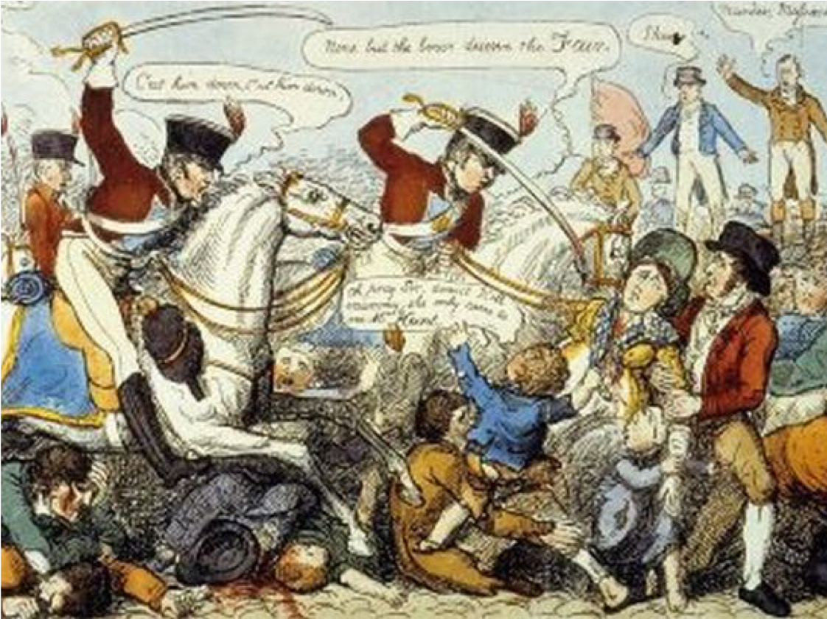
200 years since the Peterloo Massacre
Notes:
We need our unions to adopt a clear policy to ‘Scrap and Replace’ the unelected Lords with a revising chamber that represents all the UK – not a tiny elite.
We believe change comes through people joining together – in unions, in parties, in campaigns – to say ‘enough is enough’.
In 2019, we will commemorate the Peterloo massacre that saw working people lose their lives fighting for the democratic rights we have today.
Background
The Peterloo Massacre took place at St Peter's Field, Manchester, England, on 16 August 1819, when cavalry charged into a crowd of 60,000–80,000 who had gathered to demand the reform of parliamentary representation.
The end of the Napoleonic Wars in 1815 had resulted in periods of famine and chronic unemployment, exacerbated by the introduction of the first of the Corn Laws. By the beginning of 1819, the pressure generated by poor economic conditions, coupled with the relative lack of suffrage in Northern England, had enhanced the appeal of political radicalism. In response, the Manchester Patriotic Union, a group agitating for parliamentary reform, organised a demonstration to be addressed by the well-known radical orator Henry Hunt.
Shortly after the meeting began, local magistrates called on the Manchester and Salford Yeomanry to arrest Hunt and several others on the hustings with him. The Yeomanry charged into the crowd, knocking down a woman and killing a child, and finally apprehending Hunt. The 15th Hussars were then summoned by the magistrate, Mr Hulton, to disperse the crowd. They charged with sabres drawn, and in the ensuing confusion, 15 people were killed and 400–700 were injured. The massacre was given the name Peterloo in an ironic comparison to the Battle of Waterloo, which had taken place four years earlier.
Historian Robert Poole has called the Peterloo Massacre one of the defining moments of its age. In its own time, the London and national papers shared the horror felt in the Manchester region, but Peterloo's immediate effect was to cause the government to crack down on reform, with the passing of what became known as the Six Acts. It also led directly to the foundation of the Manchester Guardian, but had little other effect on the pace of reform. In a survey conducted by The Guardian in 2006, Peterloo came second to the Putney Debates as the event from radical British history that most deserved a proper monument or a memorial. Peterloo is commemorated by a plaque close to the site, a replacement for an earlier one that was criticised as being inadequate as it did not reflect the scale of the massacre.

Slide 9
What do the public think?
Polls show two thirds of voters want to scrap and replace the lords with fairly-elected representatives
Notes:
Recent research from BMG showed that in general, there is widespread support for reform.

Slide 10
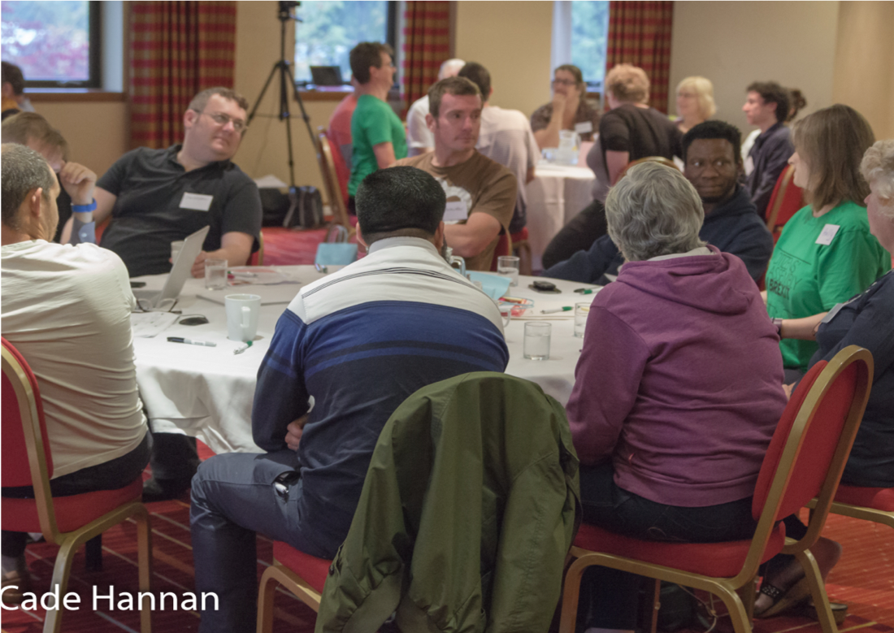
What is a constitutional convention?
Notes:
A Constitutional Convention is a process for involving members of the public in making decisions about the constitutional shape of a country, region, nation or state. Conventions and assemblies on constitutional issues have been held in a number of countries and regions, including Ireland, Iceland and British Columbia. The UK also has experience of constitutional conventions, most notably the Scottish Constitutional Convention which paved the way for the creation of the Scottish Parliament.
The design and composition of these conventions reflect the unique geographical, historical and political make up of each of these areas, and the moment in time in which the conventions took place. While there are lessons to be drawn, the UK will need a convention suited to its own distinct composition and needs.
Why a Convention now? There is a public expectation and desire to be more involved in important political decisions, combined with a worrying lack of trust in politics to deliver. To have legitimacy and longevity, the future of devolution in the UK should take its next step with citizens in the forefront. These constitutional issues need to be made with the input and support of citizens across the UK. After all, these issues have to do with things people really care about – their identity, the state of the economy, how public services are run and how the places where people live are shaped and governed. How can citizens not be involved in deciding where power should lie?

Slide 11
How you can get involved?
Join politics for the many
Write to your union magazine
Pass the model motion
Notes:
Join Politics for the Many on Facebook https://www.facebook.com/PoliticsfortheMany/
Write a letter to your paper or union magazine backing an overhaul of the Lords
Got a skill, an idea, or want to find out more? Get in touch: politicsforthemany@gmail.com
Can you pass this trade union motion in your branch? We can help or may be able to send a speaker – get in touch.
[Conference believes that] To secure a politics to favour the many and not the few, we need an overhaul of Westminster’s broken political system.
From an unelected Lords to London-dominated institutions, the UK’s undemocratic constitution is stacked against working people.
Long-lasting change is needed to ensure economic and social justice for the whole of the country – and to ensure it lasts.
Labour and the vast majority of voters want to see Westminster’s elite-dominated politics overhauled to work in the interests of working people and the trade unions who represent them (BMG Research, September 2018).
Yet we have an unelected House of Lords that behaves more like a private members’ club than the revising chamber we need.
If power continues to be hoarded by an unelected elite in Westminster we cannot achieve social and economic change and advance the goals of trade unions and working people across all parts of the UK.
In the 200th anniversary year of the Peterloo massacre – marking the Chartists’ proud fight for real democracy – we must carry on that unfinished struggle today.
This union agrees that:
The House of Lords must be abolished and replaced with a fairly-elected Senate of the Nations and Regions, to strengthen the voice of all parts of the United Kingdom and give us a revising chamber for the people.
A constitutional convention to look at wider reform of our state and politics to make it fit for the 21st century and to ensure that the people have a say in the way they are governed.
These must be done as a priority to ensure the gains of a progressive government can last.

Slide 12
discussion

