Slide 1
Politics for the many
The Trade Union Campaign for Political Reform
Notes:
Thank you for coming along – I’m Nancy Platts, co-ordinator of Politics for the Many campaign.
Politics for the Many is the trade union campaign for political reform.
We are interested in a fairer voting system and that’s where our focus is at the moment, but we’ve also done quite a bit of work around House of Lords reform.
As you may be aware Unison abstained on the vote at Labour Conference last year so we want to offer trade unionists the opportunity to learn more about how our voting system impacts on working people and ensure you feel confident about discussing and debating this because it’s currently a hot topic with motions going to trade union conferences.

Slide 2
Is it a fair voting system if…
It takes on average:
38,000 votes to elect a Conservative MP
50,000 votes to elect a Labour MP
300,000 votes to elect a Liberal Democrat MP
800,000 votes to elect one Green Party MP
Notes:
This slide speaks for itself – this is because a First Past the Post system ignores millions of votes – it’s winner takes all and the winner doesn’t even need to get more than half the votes to become an MP.
And we’ll come on to talk about why that is.
But for now, as you can see, if people vote for the Party they want to support, if they live in the wrong part of the UK, their vote won’t have any impact. And for those of you who knock on doors, you’ll have heard people say there’s no point in voting.
We’ll also come on to talk about how others are forced to game the system.

Slide 3
General elections
1951
Labour win majority of votes, but lose election
2010
Conservatives get 36% and go into coalition with Lib Dems on 23%
2015
Conservatives win a majority of MPs on less than 37% of the vote
2017
DUP puts Conservatives back in power on combined 43% of the vote
2019
Conservatives gain power on 43% of the vote
Notes:
First Past the Post – the system used to elect MPs – is a ‘majoritarian’ electoral system. It is designed to create single-party governments and ensures that parties get a majority of seats – almost always without them getting a majority of votes.
The system is meant to work when there are only two main parties contesting elections – when one party is likely to get a majority, or close to a majority, of votes.
However, with many more parties contesting elections in the UK, votes are being spread around much more widely. This has let the Conservatives hold on to power with a minority of the vote.
Nowadays, we have many more political parties putting forward candidates but under the FPTP system, their support is usually swept away. n recent elections, the Conservatives then worked with first the Lib Dems and then the DUP to secure power.

Slide 4
ECONOMIC INEQUALITY
Conservative £3.6bn ‘Town’s Fund’ to improve towns in England
Research showed it favoured Conservative marginals
Conservative marginals were not the most deserving areas
2020 study - Labour councils have borne the brunt of govt cuts
2019 BBC - increase in schools funding to conservative constituencies
Notes:
The FPTP voting system creates an incentive for governments to funnel public funding to a handful of swing seats that they need to take power.
The Conservative ‘Town’s Fund’ – a £3.6 billion fund to improve towns across England and ‘level up’ regions – has been investigated by the Public Accounts Select Committee and a report published by the National Audit Office over concerns about the distribution of these funds.
Academic research has shown that the ‘Towns Fund’ not only disproportionately favoured Conservative-held towns but specifically those in which the Conservative lead was marginal.
The researchers also ruled out the possibility this was a coincidence – the Conservative marginals were not the most deserving areas.
We see this time and time again. A study earlier in 2020 showed that Labour councils have borne the brunt of local government cuts over the past decade.
And in 2019, the BBC found that Conservative-held constituencies were overwhelming beneficiaries of the government’s increase in schools funding.

Slide 5
Trade union rights ripped up
Law on trade unions most restrictive in western world
Voting system
= tug of war
14 employment & trade union acts soon after general elections
List of statutory obligations on trade unions has grown
EU countries with embedded TU rights have PR systems
Notes:
FPTP creates a see-saw effect allowing for sweeping legislation that has eroded trade union rights.
Law on trade unions in Britain is frequently described as the most restrictive in the western world.
Trade union rights have been the target of sweeping reforms by right-wing governments here when they secure power.
Over the last forty years successive UK governments have played tug of war with the rights of trade unions.
Since 1980 there have been no less than fourteen employment and trade union acts restricting and then, to a degree, clawing back union rights.
The list of statutory obligations on unions has grown exponentially as majority governments have sought to restrict and heavily regulate trade union activity, and further reduce the potential challenge to power.
In all cases the legislation has been introduced to parliament in less than seven months after the election.
By contrast, all of the EU countries which have embedded trade union rights, and have high union density and collective bargaining coverage, are democracies which employ PR electoral systems.

Slide 6
rigged representation & equalities
Safe seats mean some MPs are there for decades with no opportunity for change
When seats do change hands, only one candidate seems to stand a chance
Limits speed of creating more diversity in parliament despite measures
92 hereditary seats in House of Lords will only go to men
Countries with proportional voting systems are generally more representative
First past the post benefits the already powerful
Notes:
The prevalence of ‘safe seats’ under Westminster’s voting system, means that once a seat is in an MP’s hands, it may be theirs for decades. It’s no wonder so many people feel disengaged from politics – in hundreds of seats, only one candidate seems to stand a chance.
It also means that despite measures to improve the diversity of candidates, the number of winnable or marginal seats that could possibly change are limited.
The number of black and minority ethnic MPs has only recently reached 10%.
Just a third of MPs are women.
The unelected House of Lords, despite the 1999 reforms, still guarantees 92 seats for hereditary peers. Not only are these positions reserved for those born into privilege, they are also almost exclusively reserved for men as succession rules mean women do not inherit titles.
The top ranked democracies in the world for women’s representation – the Nordic states, Mexico, South Africa and Spain – all use forms of PR.
In addition, PR is an enabler of techniques for increasing women’s representation such as ‘zipping’ in which party lists alternate genders. Instead, with just one seat up for grabs in each area, First Past the Post benefits the already-powerful.
Of the 2019 parliamentary intake, 29% of MPs had been educated privately, compared to about 7% of the population. Only just over half of MPs (54%) went to a comprehensive school compared to 88% of the population.

Slide 7
fairness
FPTP means elections are fought in a handful of marginal (swing) seats
The number of swing seats is in decline
These seats are vulnerable to financial influence
Notes:
Under FPTP elections are fought in just a small number of marginal (swing) seats.
The number of these swing seats is in long term decline so very few seats are in fact ‘up for grabs’, with the rest of the country often viewed as a write-off.
As in the US, under the UK’s Westminster system there is a huge amount to be gained by spending big in these marginal constituencies.
But experts have argued that the UK is more vulnerable to financial influence than the US as a lot can be gained by relatively small amounts.
This not only means that wealthy individual donors have an outsized influence on our politics but it creates an incentive to circumvent campaign regulation to funnel money into marginal constituencies.
The growth in online campaigning and lack of regulation means this is increasingly easy to do, leaving our elections vulnerable. In this environment, dark money has crept into UK politics leaving it wide open to the influence of foreign governments and wealthy individuals.
The government’s most recent proposals for campaign regulation will tighten UK based campaigning activity for charities and Trade Unions, whilst doing nothing to stop corporate donations from shell companies and unincorporated associations funnelling money from overseas – loopholes that the Electoral Commission has been warning about for years
Closing campaign donation loopholes is important but when complete power can be won by swinging a small number of marginal constituencies, without reform of the electoral system, the UK’s democracy will always be more vulnerable to the influence of wealthy individuals.

Slide 8
Gaming the system
The smaller parties that favour electoral reform tend to be more left wing
Labour stands to gain from changing the system but is punished by FPTP
Conservatives dominate the right
This means one unified right wing party vs all three progressive ‘left’ parties
Leads to tactical voting and vote swaps
Parties forced to discuss alliances and not standing candidates
Notes:
The smaller parties that favour electoral reform tend to be aligned more closely with Labour.
This means Labour stands to gain from changing the system but is being punished under the current one.
Analysis of the 2021 English local elections shows more candidates being fielded from the left of centre than the right – splitting the progressive in many seats.
Conservatives are dominating the right of politics whilst the left of centre parties are competing with each other.
In nearly half of wards (48%), there was one unified ‘right’ party (the Conservatives) standing candidates against all three of the ‘left’ parties (Lab/LD/Green).
The trend for voters to try to ‘swap’ their votes at elections is another example of the system forcing voters to try to work around the system.
Parties themselves are also forced into discussions of how to game the system through alliances and candidates standing down. This would be unnecessary under PR: you could always vote for who you support.

Slide 9
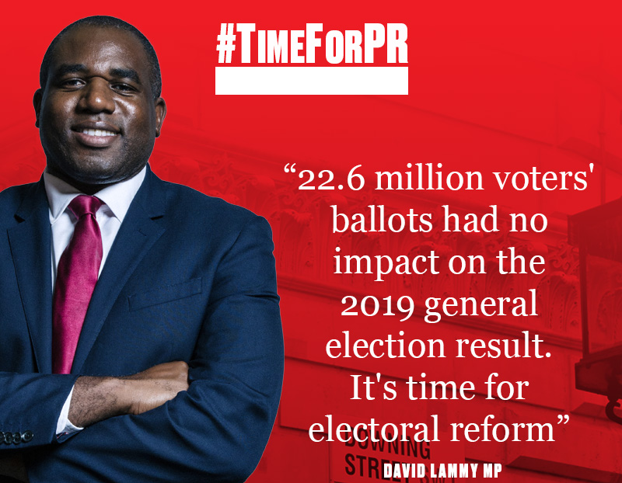
SUPPORT FOR pr
83% Of Labour Members
CLPs
Unions
MPs
Momentum
Compass
Notes:
Calls for change are growing louder in the labour movement.
In May, the ASLEF union became the latest to back change to Westminster’s warped voting system.
Latest polling shows 83% of Labour members believe the party should support changing the UK’s electoral system to proportional representation, up from 76% less than two years ago. The poll of nearly 1,000 Labour members, conducted by YouGov for Labour for a New Democracy, showed that just 10% say Labour should not support the switch from First Past the Post to a form of proportional representation.
Hundreds of Labour branches and CLPs have now passed motions calling for electoral reform. From the PCS to the TSSA, from Momentum to Compass, more and more in our movement recognise that we cannot secure the lasting redistribution in power in this country without an overhaul at Westminster.
Politics for the Many is supported by leading trade unionists across all Labourlinked unions and beyond, and we want to step our campaigning up a gear.

Slide 10



Get involved
Join
attend
Motion
Politics For The Many – It’s Free!
Come To An Event
Pass A Motion At
Your Branch
Notes:
Get involved here by joining P4M – it’s free! https://politicsforthemany.co.uk/
Come to one of our online events
Pass a motion in your union backing proportional representation
Book a speaker by emailing us at: admin@politicsforthemany.co.uk
Follow us on Twitter @politics4many
Find us on Ffacebook.com/PoliticsfortheMany

